Slide 1
The heart as a pump

Slide 2
The heart is two pumps in series. Thin walled atria act as reservoirs to supply muscular pumping chambers - the ventricles.
In-flow and out-flow to the ventricles are separated by valves. The right side of the heart pumps blood to the lungs (pulmonary circulation), the left side to the body - or systemic circulation.
Cardiac muscle is a specialised form. The myocardium consists of individual cells joined by low electrical resistance connections.
The contraction of each cell is produced by a rise in intracellular calcium concentration triggered by an all or none electrical event in the cell membrane - the action potential.

Slide 3
The cardiac action potential is very long, so over most of the heart a single action potential will produce a sustained contraction of the cell lasting about (200 - 300 )ms. Action potentials spread from cell to cell, so at each heart beat all the cells in the heart normally contract.
Pumping action requires a regular, co-ordinated pattern of contraction. Action potentials are generated spontaneously at regular intervals by specialised pacemaker cells. In the normal heart the pacemaker is the sino-atrial node, in the right atrium. Excitation spreads over the atria to the atrio-ventricular node, and thence down the muscular septum between the ventricles to excite the ventricular muscle from the endocardial side, from where the contraction spreads through the ventricular myocardium and up towards the AV junction where the valves are located.

Slide 4
The period when the myocardium is contracting is known as SYSTOLE
The period of relaxation between contractions is DIASTOLE
Contraction of the atria is not forceful, but the ventricular muscle is organised into figure of eight bands which squeeze the ventricular chamber forcefully in a way most effective for ejection through the out flow valve.
The apex of the heart contracts first and relaxes last to prevent back flow

Slide 5
The cardiac cycle is the sequence of pressure flow changes and valve operations that occur with each heartbeat.
As the ventricular muscle relaxes (i.e. early diastole), the intra-ventricular pressure falls, and the atrio-ventricular valves (tricuspid and mitral) open as atrial pressure exceeds ventricular.
The atria have been distended by continuing venous return during the preceding systole, so initially blood is forced rapidly from the atria into the ventricles - the 'rapid filling' phase.
Fillingof the ventricles continue throughout diastole, at a steadily decreasing rate until the intra-ventricular pressure rises to match atrial pressure. At low heart rates the ventricles are more or less full before the next systole begins.

Slide 6
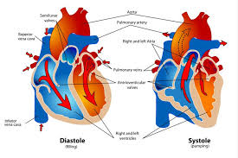

Slide 7
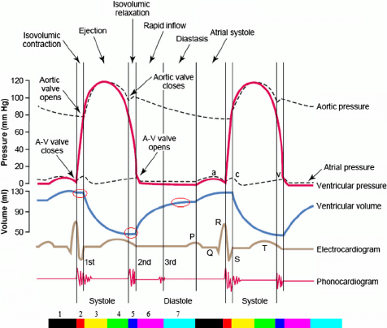

Slide 8
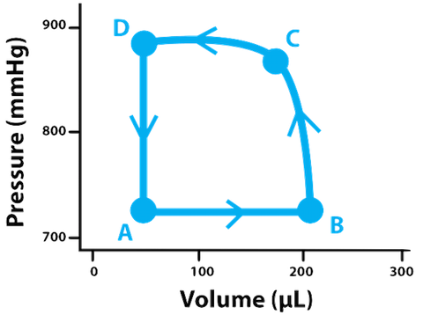

Slide 9
Atrial systole is the contraction of the atria, which forces a small extra amount of blood into the ventricles. After a delay of about (100-150) ms the ventricles begin to contract (systole) .
As intra ventricular pressure rises, so blood tends to flow the 'wrong way' through the A/V valves, producing turbulence which closes the valves forcibly.
The ventricles then contract 'isovolumetrically' and intra ventricular pressure rises rapidly until it exceeds the diastolic pressure in the arteries, when the outflow (aortic and pulmonary) valves open. There is then a period of rapid ejection of blood, and both intra ventricular and arterial pressure riseto a maximum. Towards the end of systole intra ventricular pressure falls, and once it is below the arterial pressure the outflow valves close, and when the atrial pressure is reached the A/Vvalves open, and the whole process starts again.
These events are associated with sounds which are often used to assess the state of the heart. Sound is produced by sudden acceleration and deceleration of structures or by turbulent flow.

Slide 10
In the normal heart there are always two sounds. Two others may be audible.
First heart sound: As the A-V valves close oscillations are induced in a variety of structures, producing a mixed sound with crescendo-descendo quality - 'lup'.
Second heart sound: As the semi-lunar valves close oscillations are induced in other structures including the column of blood in the arteries. This produces sound of shorter duration, higher frequency and lower intensity than the first - 'dup'.
A third sound may be heard early in diastole, and a 4th sound is sometimes associated with atrial contraction.
In exercise turbulent flow generates 'murmurs' in normal individuals, but at rest murmurs are associated with disturbed flow, say through a narrowed valve, or back flow through an incompetent valve.

Slide 11
Cardiac output: The volume pumped per minute by the left heart is known as the CardiacOutput. As the pumping is intermittent, it is the product of the volume ejected per cardiaccycle - stroke volume and the number of cycles per minute - the Heart rate. Both may vary.

